Slide 1
An Introduction to
Neural Networks & Deep Learning
IUT AI Student Chapter

Slide 2
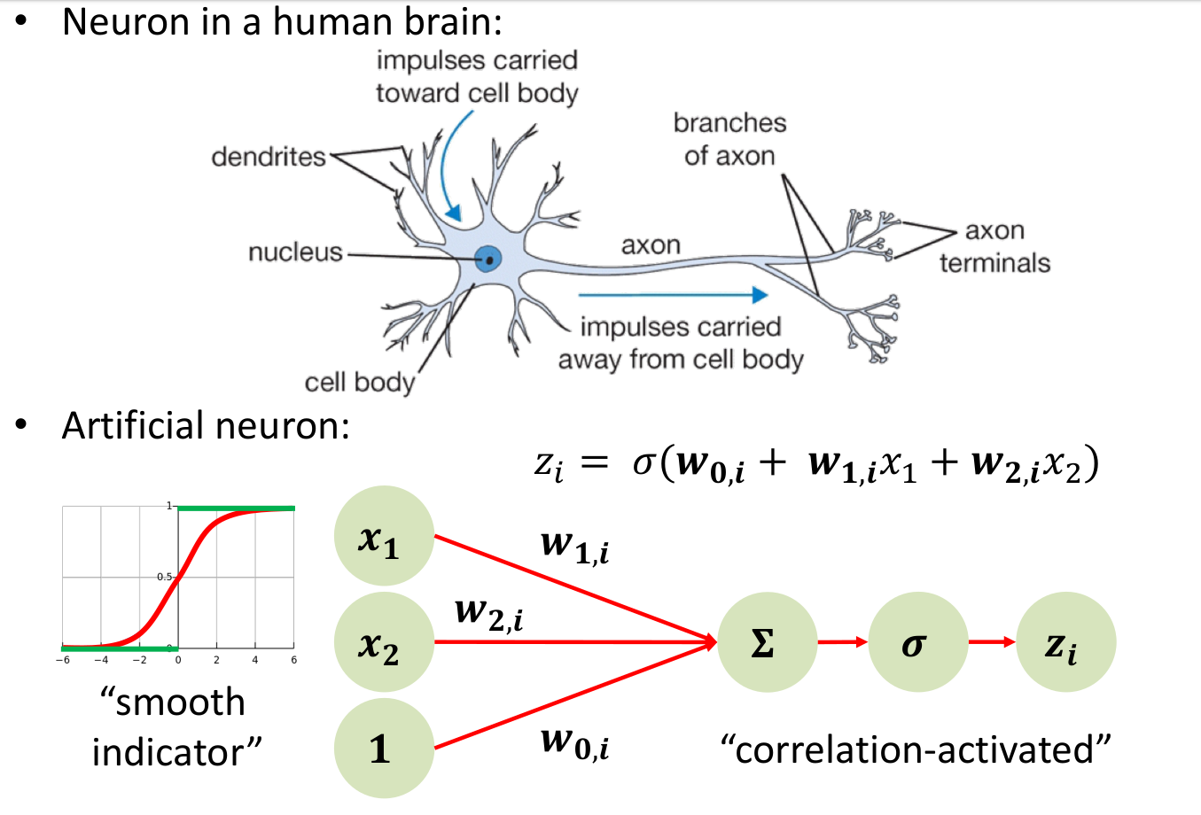

Slide 3
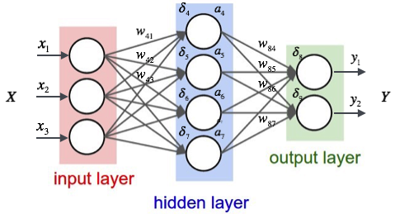
Neural Network

Slide 4


Slide 5

Deep Learning
￼

Slide 6
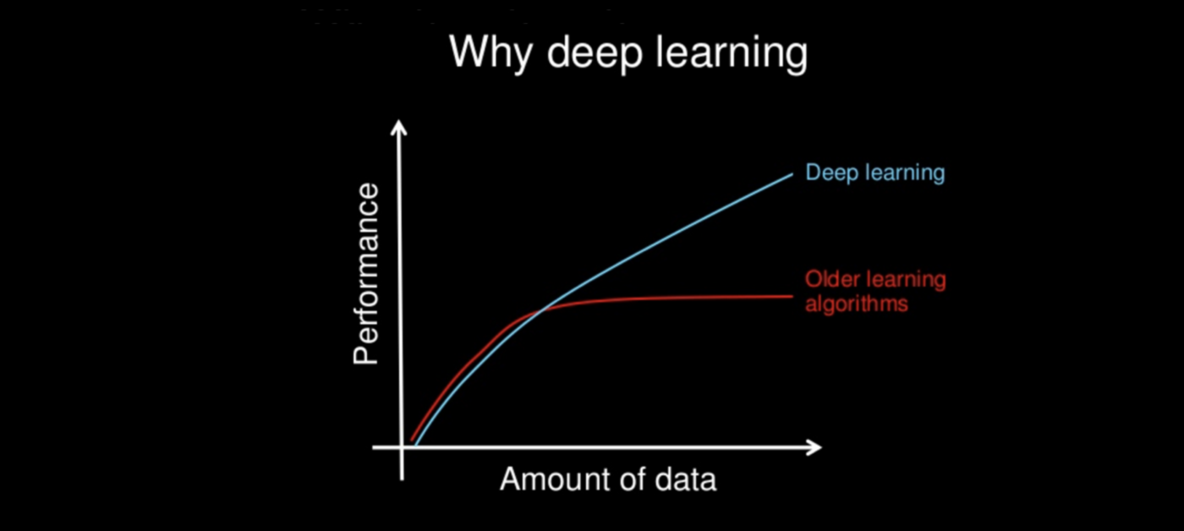

Slide 7
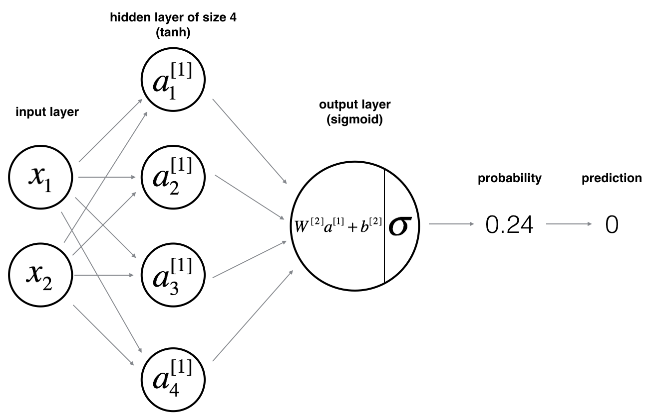
Zoom In

Slide 8
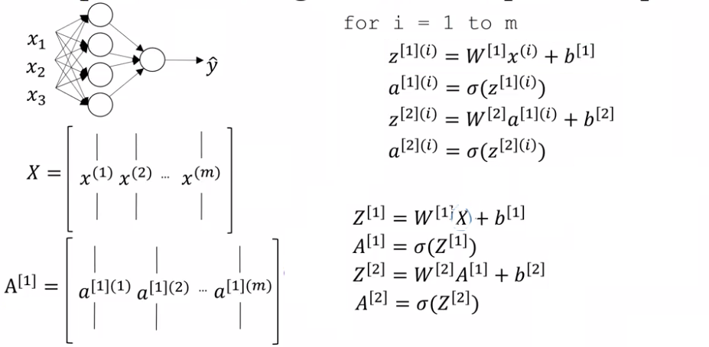
FeedForward

Slide 9
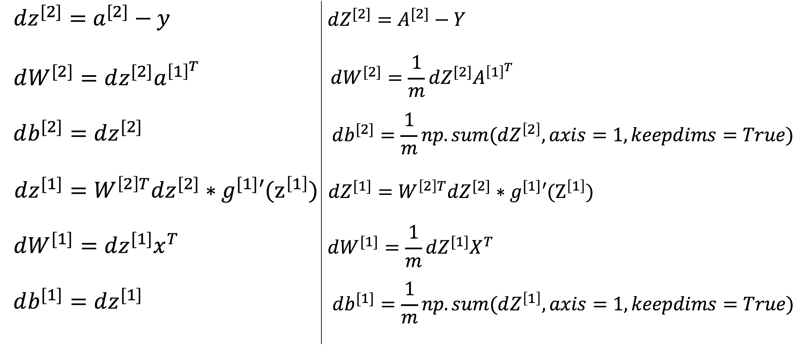
Summary of Gradient Descent

Slide 10
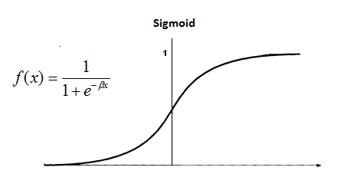
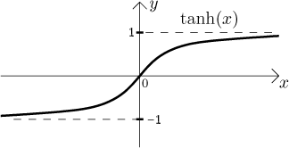
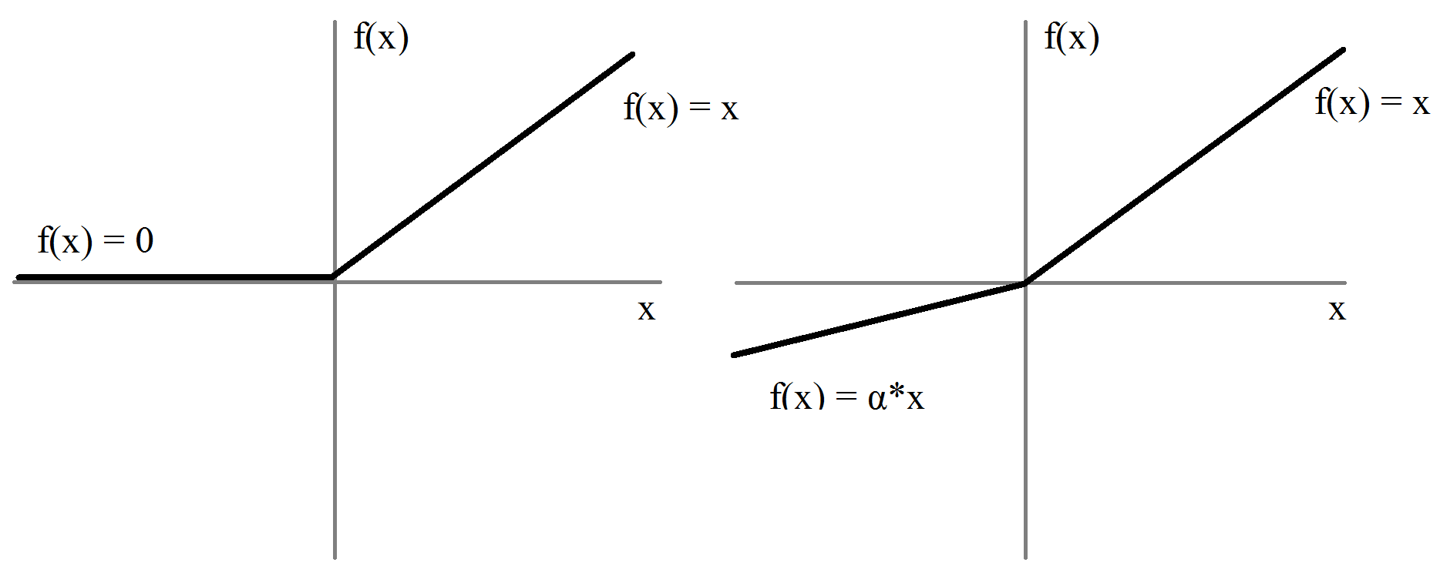
Activation Function
Relu
Leaky Relu

Slide 11
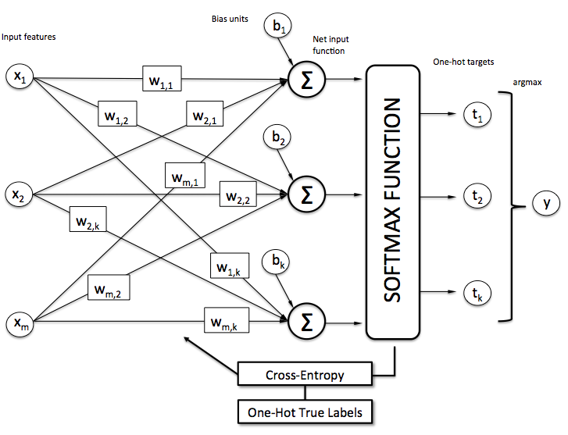
An Overview

Slide 12
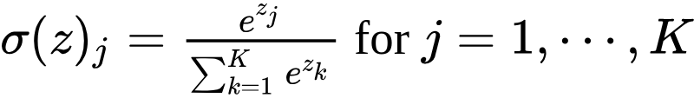
Softmax function

Slide 13
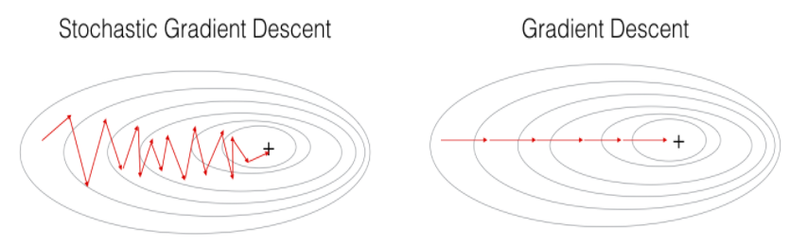
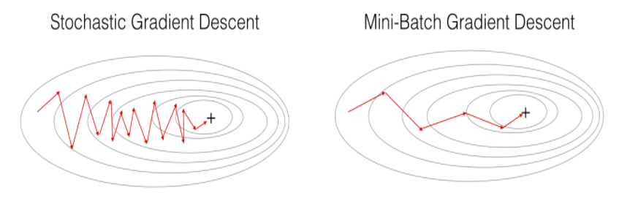
Optimization

Slide 14
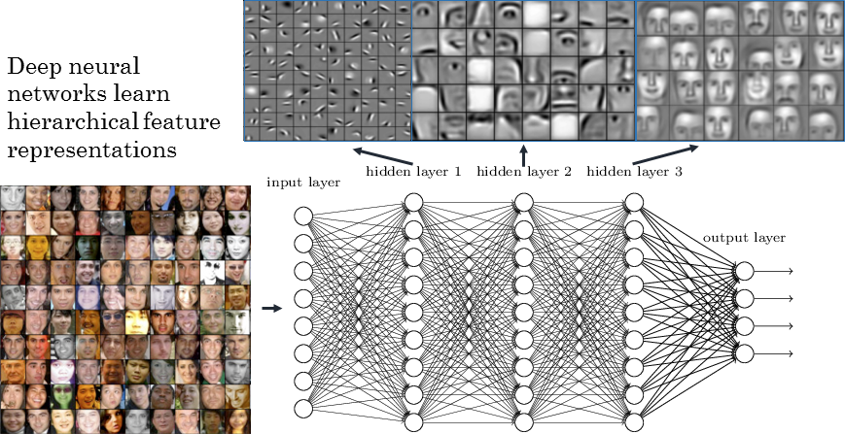
Problem

Slide 15

Convolution Neural Network

Slide 16

Time series and Sequence

Slide 17
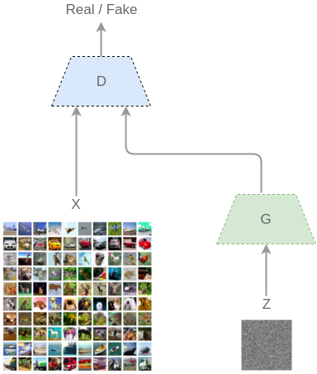
GAN

